Slide 1
COVID-19 and Renin Angiotensin Aldosterone System: Pathogenesis and Therapy
By
Teachers and Students of Clinical Biochemistry Department, Kermanshah University of Medical Sciences

Slide 2
The RAAS pathway overview
**The existence of a“local”pulmonary RAAS that can be differentiated from the “systemic”circulating RAAS.
**The RAAS components act in two opposite axes: the classical axis composed ACE, Ang II, and AT1R involved in body fluid homeostasis. Also, this axis triggers vasoconstriction and cardiac hypertrophy and produces reactive oxygen species
**The alternative axis consists of ACE2, Ang-(1-7), and the Mas receptor, which counter-regulates the classical RAAS axis and has vasodilatory, anti-inflammatory, and anti-thrombotic effects and inhibits the cell growth and ROS production.

Slide 3
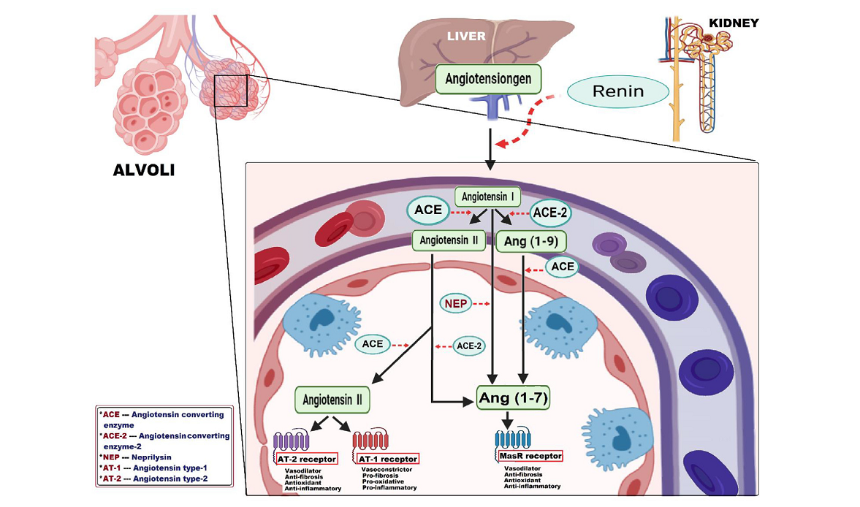

Slide 4
Neprilysin and the RAAS
**Neprilysin (NEP), a neutral endopeptidase is highly expressed in the kidneys and lungs. Increased NEP activity might be involved in decreased COVID-19 severity by diminishing **Ang II formation through preventing the proteolytic cleavage of angiotensinogen to Ang I and Ang I into Ang II and directing Ang I to generate Ang-(1–7).
**NEP degrades BKs and therefore prevents the activation and recruitment of the inflammatory cells.

Slide 5
Kallikrein/kinin pathway and crosstalk with the RAAS
The serine protease kallikrein converts the inactive pre-protein kininogen to bradykinin (BK). Bradykinin induces vasodilation, natriuresis, and hypotension through activating the B2 receptor.
**BK is involved in the inflammatory response following injury.
**Bradykinin is degraded by ACE that is an important aspect of blood pressure regulation.
**There is a crosstalk between the RAAS and the kallikrein/kinin pathways as BK receptor signaling is augmented by Ang-(1-9).

Slide 6
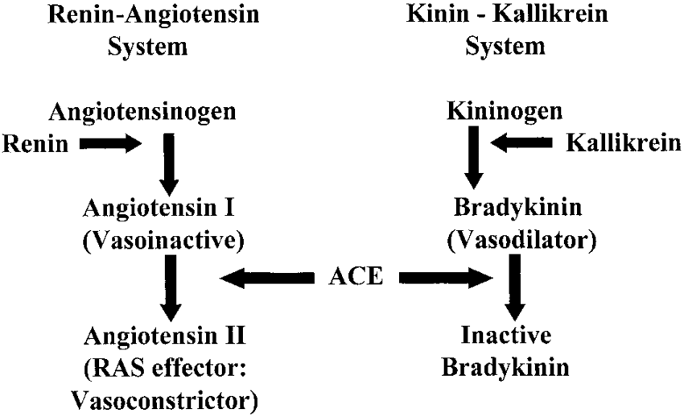

Slide 7
**Interaction between Ang-(1-7) and bradykinin
**Ang-(1-7) in opposition to those of AT-1 receptor, activation such as vasodilator, anti-inflammatory, anti-hypertrophy, anti-proliferative, anti-fibrosis and antioxidant effects.
** A powerful link between the vasodilator effect of Ang 1–7 and its higher plasma levels in females; making them less liability to hypertension than males.
This interaction mostly occurs in blood vessels as Ang-(1-7) potentiates BK and also kinins mediate the vascular functions of Ang-(1-7).
**Ang-(1–7) stimulates the bradykinin (BKs) pathway via preventing the BK hydrolysis.

Slide 8
**Ang (1–7) could be as a potential therapeutic agent able to mitigate the lung injury in patients with COVID-19 infection, without increasing ACE-2 activity.
**Angiotensin-(1–7) is one part of the protective the RAAS axis. This peptide binds to AT2R and MasR. Ang-(1–7), and MasR agonists could be used in the treatment of patients with severe COVID-19.
**Hydroxypropyl-β-cyclodextrin–Ang-(1–7) complex
**Intravenous infusion of cyclic Ang-(1–7)

Slide 9
**During the process of aging, chronic elevation of Ang II evokes generation of reactive oxygen species (ROS) via binding with AT1R to activate NADPH oxidase.
**Local formation of Ang II is increased in aged hearts, and chymase is primarily responsible for this increase.
**Chronic exercise is able to normalize the age-dependent alterations via compromising chymase/Ang II/angiotensin type 1 receptor/Nox actions while promoting ACE2/Ang 1-7/MasR signaling.

Slide 10
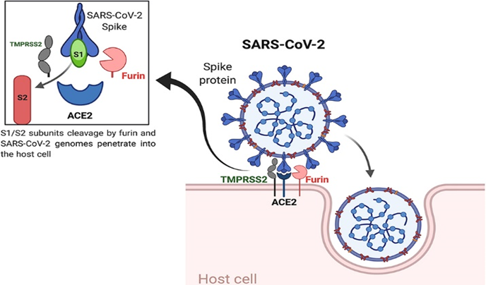
ACE2 and COVID-19 pathogenesis
ACE2
The discovery of ACE2 as the primary receptor for a novel coronavirus.
ACE2 is a crucial component of the renin-angiotensin-aldosterone system(RAAS)

Slide 11
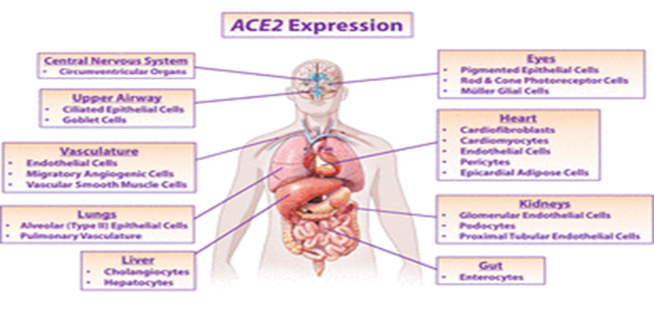
ACE2 and COVID-19 pathogenesis
Distribution of ACE2
ACE2 is also expressed in cell types such as type I alveolar cells, bronchial epithelial cells, fibroblasts, endothelial cells and macrophages.
RAAS and ACE2 activity is high in the lungs

Slide 12
ACE2 and COVID-19 pathogenesis
The effect of COVID19 on ACE2
The affinity between the binding of the S1 subunit and the host ACE2 receptor determines the host susceptibility to SARS-CoV2 infection.
SARS-COV2 uses ACE2 as RBD for its S protein. As a result, increased ACE2 expression can increase SARS-CoV2 infection.
It is suggested that decreased pulmonary ACE2 activity associated with the expression of cytokines may play a role in the pathogenesis of pneumonia.

Slide 13
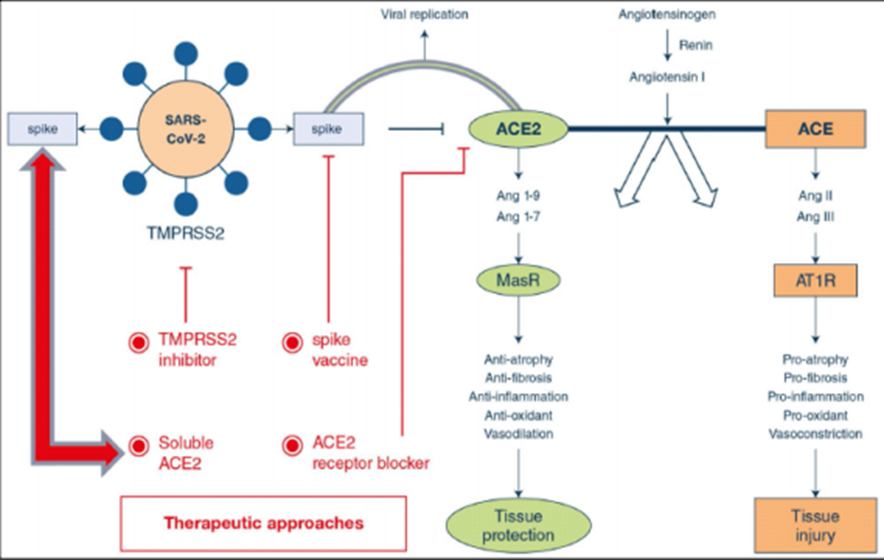
ACE2 and COVID-19 pathogenesis
Decreased ACE2 receptor

Slide 14
ACE2 and COVID-19 pathogenesis
Mesenchymal stem cells (MSCs)-based immunomodulation treatment
Hypomethylation and overexpression of ACE2

Slide 15
COVID-19 and therapy
The human recombinant ACE2( rhACE2 )
ACE inhibitors and angiotensin receptor blockers
Renin Inhibitors :
A ) Beta-adrenergic blockers
B ) Vitamin D
Antihyperglycemic drugs and RAAS and COVID-19
Janus activated kinase (JAK) inhibitors
Resveratrol

Slide 16
The human recombinant ACE2( rhACE2 )
It has been known that the ACE2 has a protective role in ARDS.
Further, the rhACE2 increases the vasculoprotective effects of ACE inhibitors or ARBs.
The ACE2 activity in circulation is significantly increased by rhACE2, along with effective reduction of Ang II levels and increased production Ang 1-7 from Ang II.
Verma et al. suggested a combination therapy by applying GapmeR technology with rhACE2 in treatment of COVID-19 patients

Slide 17
Metalloprotease-17 (ADAM17) in course of the physiological situation and in SARS-CoV infection can cleave and release the extracellular domain of ACE2 named soluble ACE2 (sACE2) ,that its enzymatic activity is still maintained .
TMPRSS2 is the other main enzyme that competes with ADAM17 for ACE2 shedding and increases SARS-CoV entry into host cell. TMPRSS2 enhances the SARS-CoV entry through ACE2 cleavage, which might increase viral uptake, and SARS-S cleavage, that could activate the S protein of virus for membrane fusion.

Slide 18
In another approach cyclodextrin (CD)-sACE2 inclusion has been suggested for the treatment of this infection. The CDs, macrocyclic molecules with pyranose units linked by the α-1, 4-glycoside chain, can enclose highly hydrophobic molecules in their hydrophobic cavities and the complex of CD and sACE2 can effectively improve the water solubility of sACE2 and can be effective in drug atomization inhalation.

Slide 19

ACE inhibitors and angiotensin receptor blockers
Commonly used in treatment of hypertensive patients. These drugs significantly increased the ACE2 and Ang (1–7) level that may suggest the protective effect of these drugs against lung injury by virus.
losartan
olmesartan
irbesartan
Telmisartan

Slide 20
RAAS blockade agents, especially ARBs can modulate both systemic and tissue RAAS. However, rhACE2 that have large molecular size has limited penetrance and activity against tissue RAAS

Slide 21
Renin Inhibitors
A)Beta-adrenergic blockers :(aliskiren)
Beta-adrenergic blockers reduced mortality rate in patients with septic shock.
Renin release from juxtaglomerular cells in the kidneys
At low doses, beta-adrenergic blockers might be useful in patients with COVID-19 who have normal blood pressure, as they may decrease the entry of SARS-CoV-2 into the cell.
Reduced the mortality rate in ARDS, septic shock, and respiratory failure

Slide 22
Renin Inhibitors
B) Vitamin D
Vitamin D is another regulator of the RAAS, since the vitamin D-vitamin D receptor (VDR) complex suppresses the expression of renin.
The BAL gene expression analysis indicated that the VDR was down-regulated and the enzymes that catabolize 1,25(OH)2-D and its precursor 25(OH)-D were up-regulated in COVID-19 patients compared to controls, which might enhance the renin. Also, some genes in the RAAS-bradykinin system have VDR binding site. Therefore, it has been suggested that some FDA-approved agents which reduce BK production and/or signaling, can decrease renin production through vitamin D, and can reduce HA synthesis through targeting HAS 1-3; however, this hypothesis needs to be tested in the well-designed clinical trials for the treatment of COVID-19.

Slide 23
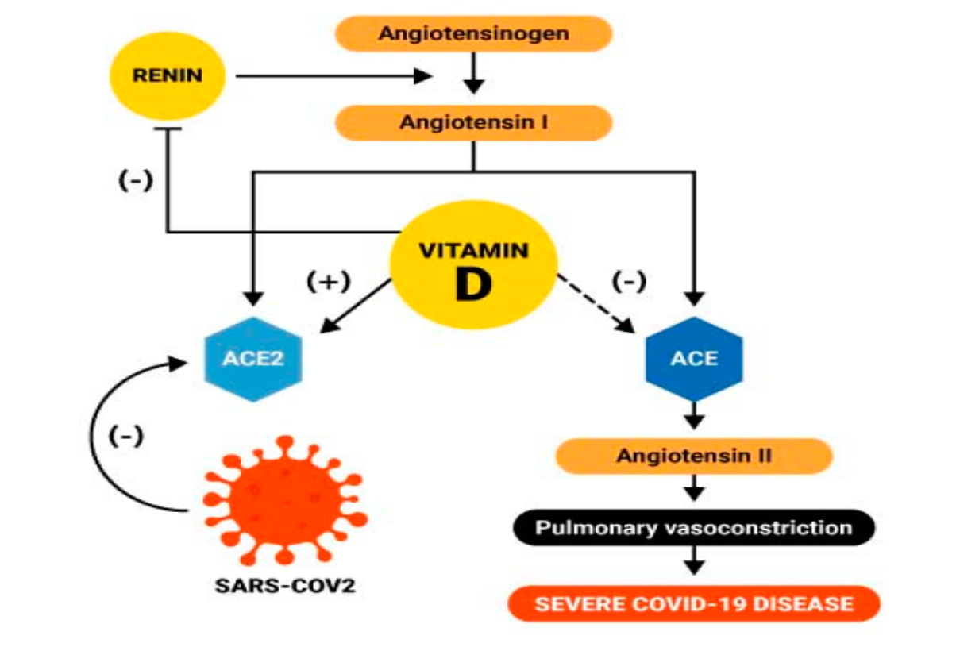
B) Vitamin D
Vitamin D increases expression of ACE2, which promotes the binding of the virus, it prevents the constriction response of the lung blood vessel in COVID-19, as illustrated in Figure.

Slide 24
Antihyperglycemic agents, RAAS and COVID-19
The RAAS plays an essential role in glucose homeostasis
ACE2 might play several roles in glucose homeostasis:
ACE2 deficiency leads to altered glucose metabolism
Loss of ACE2 increases insulin resistance
Hyperglycemia stimulates tissue RAS and vice versa
The localization of ACE2 expression in the endocrine part of the pancreas

Slide 25
Antihyperglycemic agents, RAAS and COVID-19
Insulin
Insulin exerts immunomodulatory effects independent of glycemic control
Treating hyperglycemia with insulin might restore ACE2
Early insulin therapy reduces the risk of developing diabetic ketoacidosis
Metformin
Inhibiting mitochondrial complex I, could be useful in reducing oxidative stress and lung injury
Peroxisome proliferator-activated receptor-g (PPAR-g) agonists
Attenuated lipopolysaccharide (LPS)-induced lung injury in murine models

Slide 26
Antihyperglycemic agents, RAAS and COVID-19
Dipeptidyl peptidase 4 (DPP4) inhibitors
Attenuated LPSinduced lung injury in mice models
Glucagon-like peptide 1 (GLP-1) agonists
Attenuated LPS induced lung injury in murine models
Sulfonylurea
Alleviate acute lung injury by inhibiting the nucleotide-binding oligomerization domain (NOD)-like receptor family, pyrin domain containing 3 (NLRP3) inflammasome signaling pathway

Slide 27
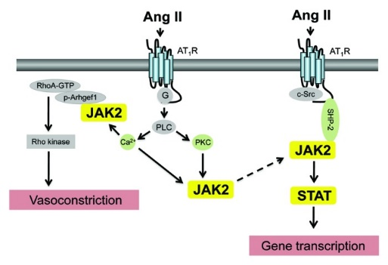
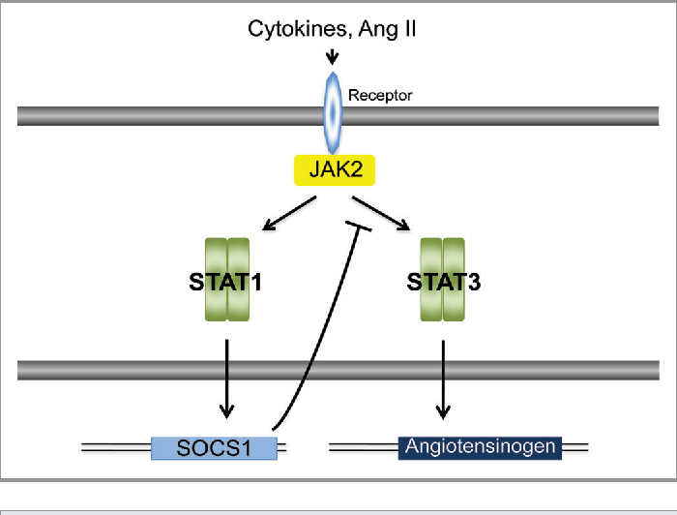
Janus activated kinase (JAK) inhibitors

Slide 28
Janus activated kinase (JAK) inhibitors
Inhibition of the JAK/STAT signaling pathway has also been suggested as a potential treatment for COVID-19
JAK2 inhibitors, such as fedratinib, enter cells via ACE2-mediated endocytosis and inhibit viral entry to the cells
In addition, entry of SARS-CoV-2 into host cells via ACE2-mediated endocytosis is regulated by upstream regulators of AP2-associated protein kinase 1 and cyclin G-related kinase (GAK)
Baricitinib, high affinity inhibitory effect on AAK1-associated endocytosis and GAK

Slide 29
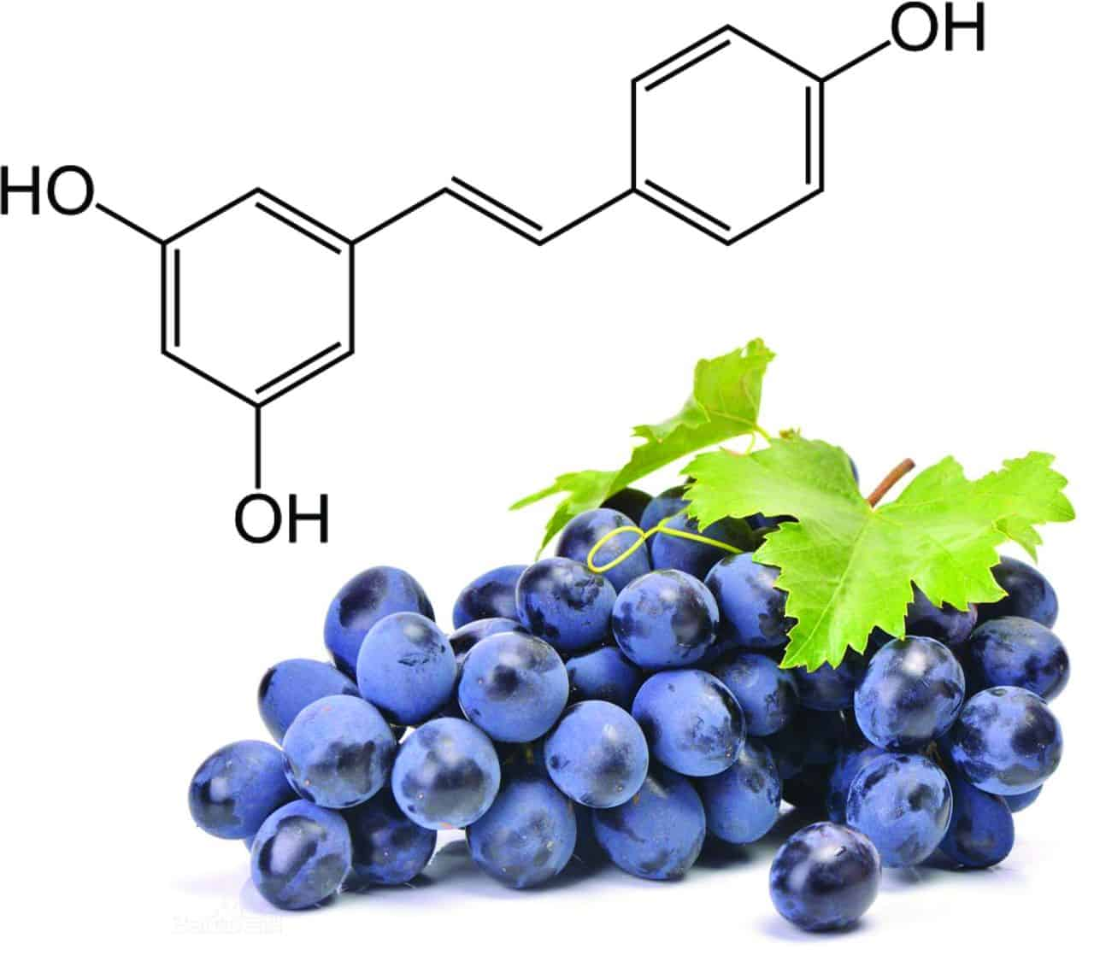
Resveratrol
An antioxidant, is safe to use with maximum of 2-3 grams daily
Suppress Ang II and also might reduce inflammation

