Slide 1
RNA-Based Technolgies Chapter 5 of clark biotechnology
نام استاد: دکتر محمد زاده
نام دانشجو: فاطمه فاتحی

Slide 2
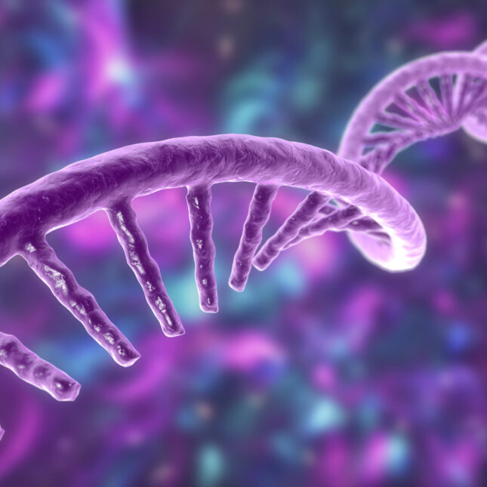
rna
Although RNA was once thought of as an intermediary in the transfer of genetic information from DNA to protein, it is now recognized that RNA plays a wide variety of other roles. Indeed, RNA is the most functionally diverse of all the biological macromolecules.
RNA helps maintain genomic structure, protects genomes from invading viral DNA, modulates transcription and translation, and can even perform enzymatic functions. The roles of tRNA, rRNA, and mRNA in proten transcription and translation are well known.

Slide 3
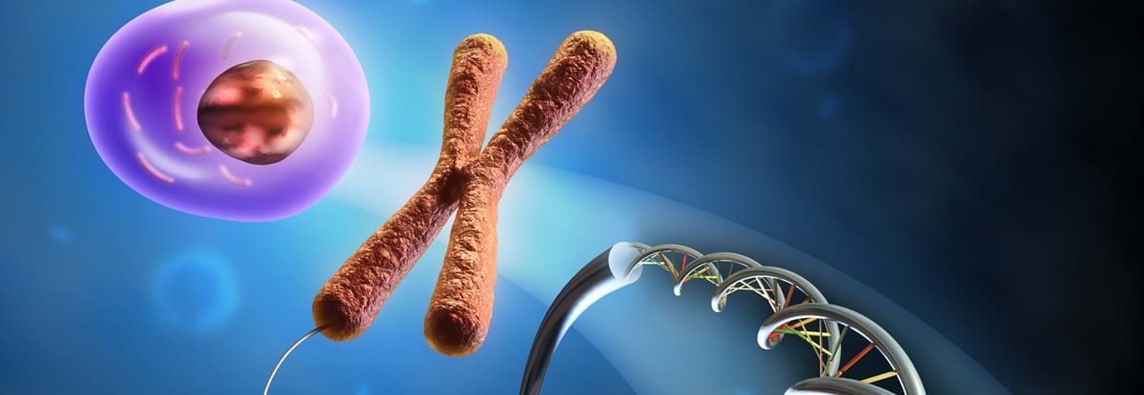
Major Classes of RNA
Genomic Integrity and Protection
Piwi interacting RNA: Transposon silencing in germline cells
Small-interfering RNA: Defense Against foreign RNA
Telomerase RNA: Synthesis of telomeres
CRISPR RNA: Defense Against foreign RNA and DNA
Xist RNA: X Chromosom inactivation

Slide 4
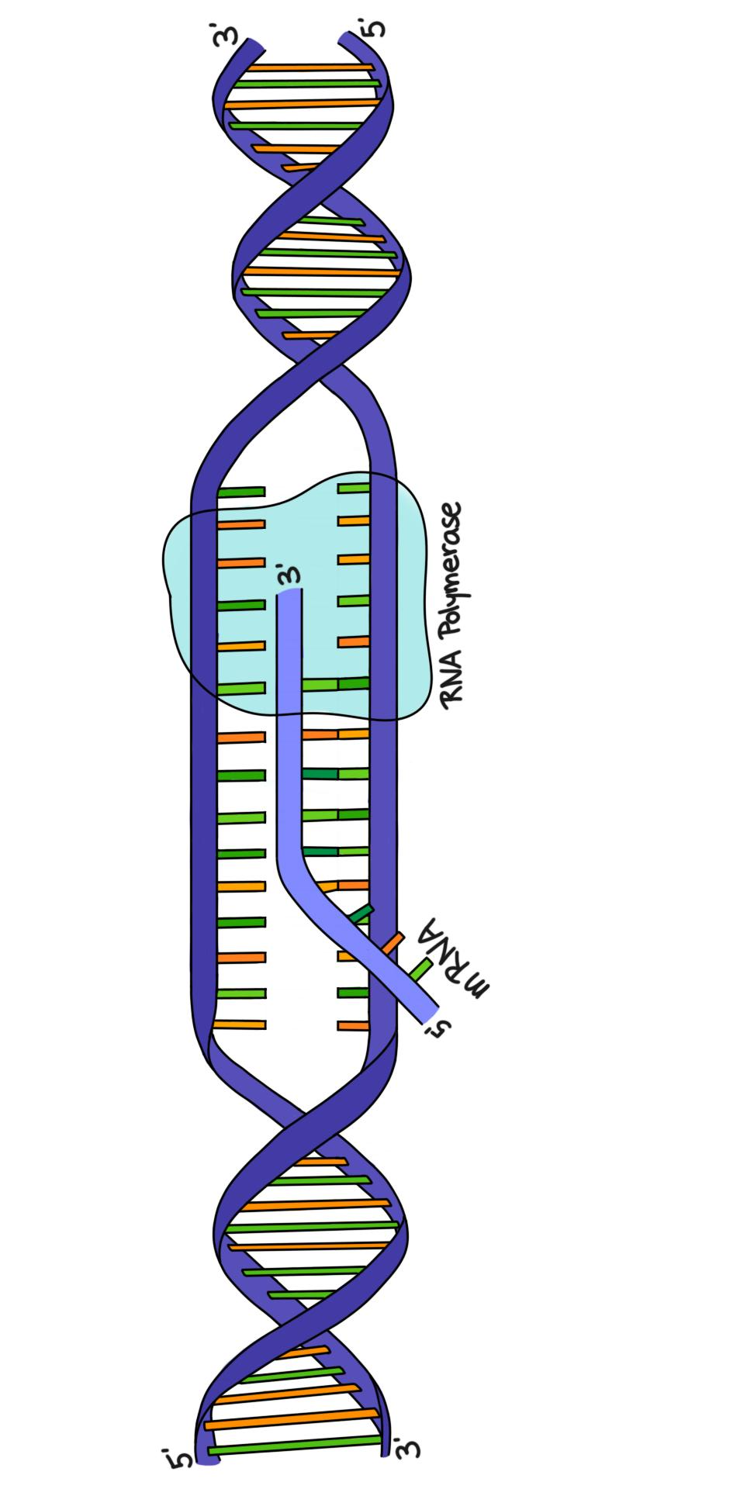
2. Transcription
Antisense RNA Genetic regulation
Enhancer RNAs Genetic regulation
6S RNA Regulating transcription
Micro RNA Regulating Mrna Degradation and translation
Circular RNA Regulation of miRNA abundance اسفنج مولکولی
Long noncoding RNA Various Regulatory roles
Small RNA regulators Gene Regulators (various mechanisms)

Slide 5
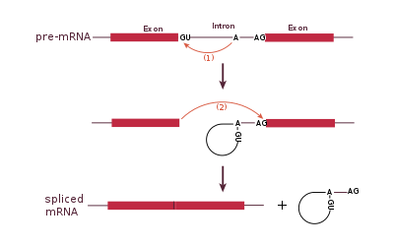
3. RNA Processing
Guide RNA: Editing of mRNA
Small nuclear RNA: Splicing of RNA
Small nucleolar RNA: RNA Nucleotide modification

Slide 6
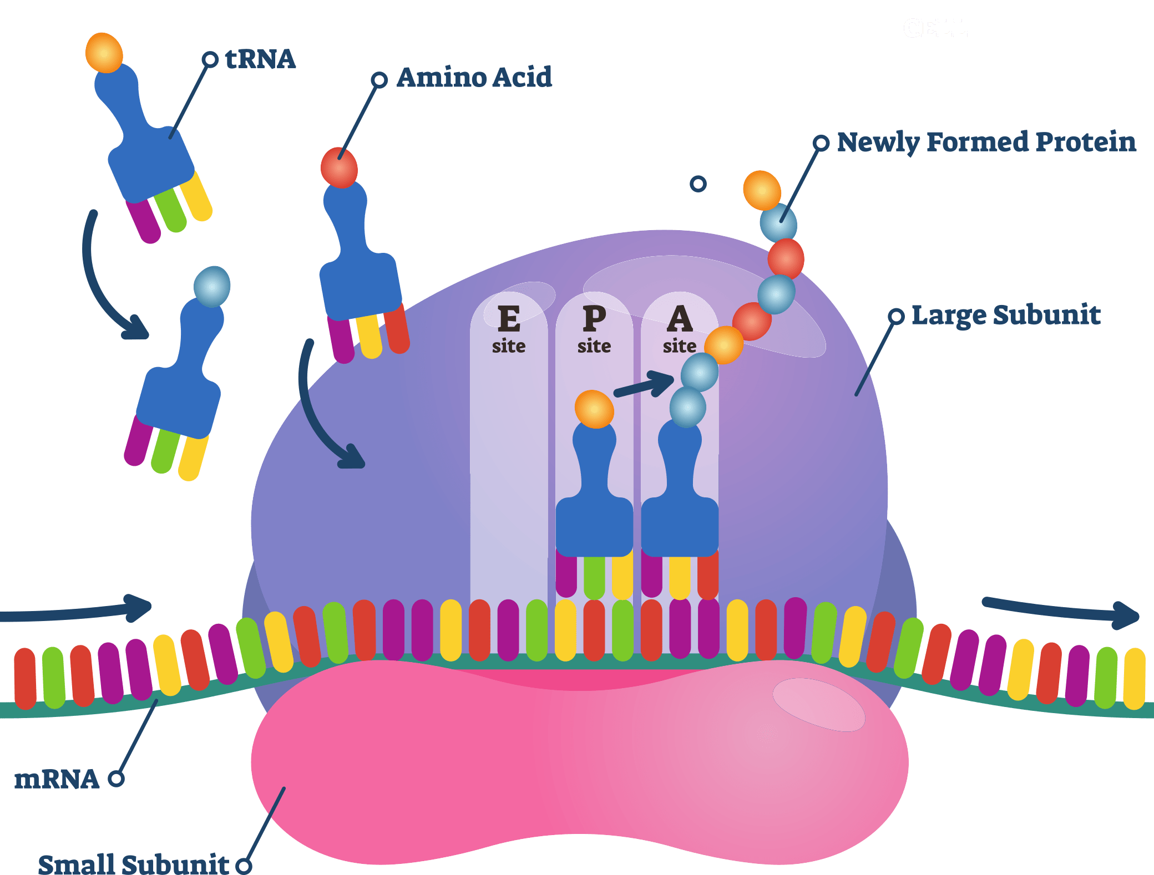
4. Protein Translation
Messenger RNA: Protein synthesis
Transfer RNA: Protein synthesis
Ribosomal RNA: Protein synthesis
Transfer-messenger RNA: Rescues Stalled ribosomes
Riboswitch: Controls translation, transcription, or splicing of attached mRNA
Dual-function RNA: Protein coding plus various regulatory roles

Slide 7
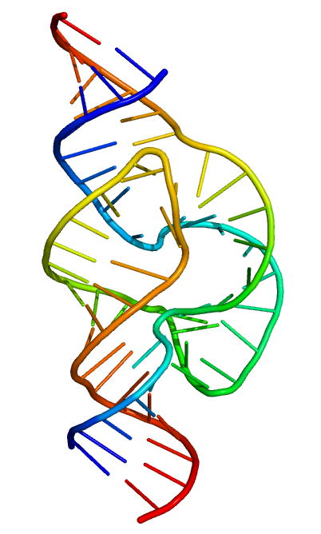
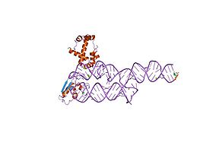
5. Enzymatic Function
Ribozymes: Function as enzymes
Signal recognition particle RNA: Membrane insertion of proteins

Slide 8
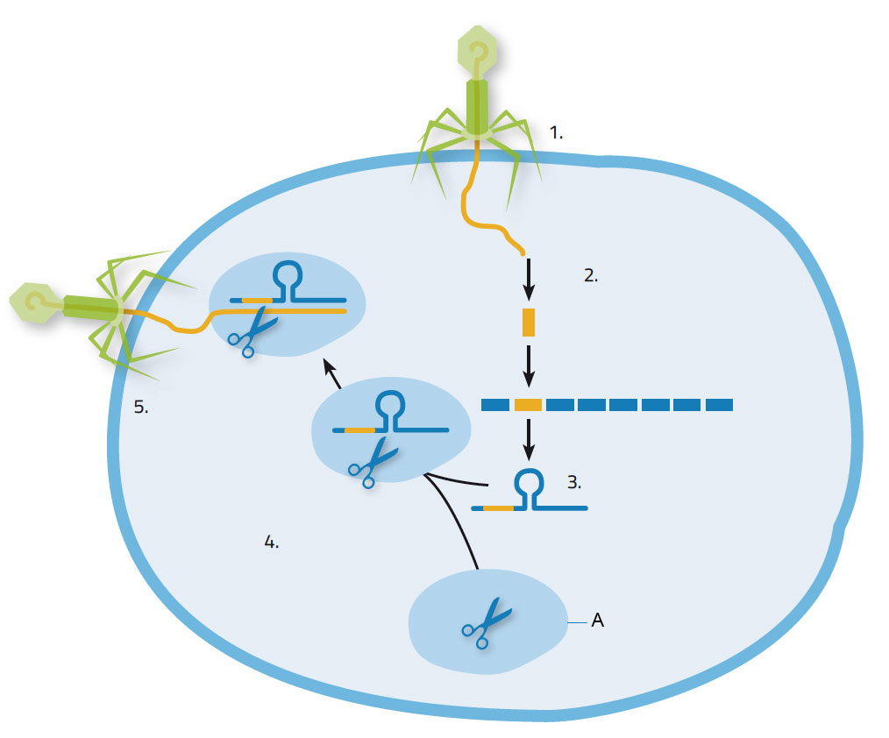
In eukaryotes, RNA interference (RNAi) plays a major role in protecting against RNA viruses.
Bacteria lack RNA interference but instead possess the CRISPR system that uses small RNAs (crRNA) to identify and combat both DNA and RNA viruses.
RNA interference protects only against viruses with RNA genomes but not DNA viruses.
CRISPR can protect against viruses with RNA or DNA genomes, as well as hostile plasmids and transposons.

Slide 9
crispr
CRISPR is based on memory. The CRISPR system stores an array of short sequence fragments derived from foreign genetic elements.
CRISPR, which stands for clustered regularly interspaced short palindromic repeats, refers to the way foreign genetic sequences are stored on the bacterial chromosome.
When nucleic acids appear whose sequences contain matches to those stored, they are destroyed. Both DNases and RNases are present among the CAS proteins, and thus, the CRISPR system can defend bacteria against both RNA viruses and DNA viruses. It also prevents the entry into bacteria of foreign plasmids and transposons.

Slide 10
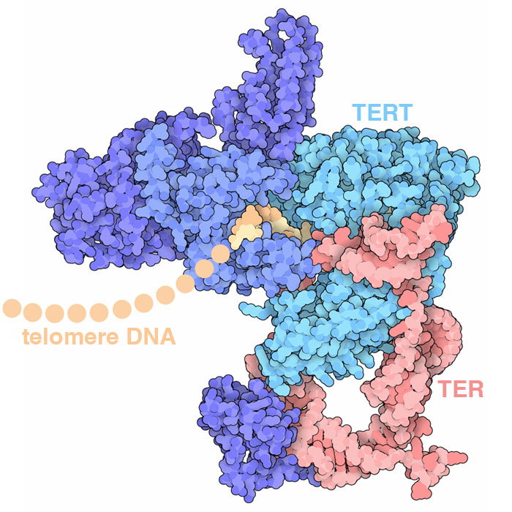
Telomerase consists of the RNA template (TERC) plus the telomerase reverse transcriptase subunit (TERT protein)
Telomerase
Telomerase reverse transcriptase, or TERT, is the major telomerase protein and contains the active site for DNA synthesis that uses the TERC RNA as a template. Several other proteins are needed for stability.

Slide 11
Pirna (piwi rna)
When piRNA gene clusters are expressed into RNA, members of the Argonaut protein family recognize the piRNA, cleave it into small pieces, and then use these pieces as single stranded templates to bind and cleave an complementary RNA produced by the transposon. This action prevents endogenous transposons from moving to new locations.

Slide 12
Antisense RNA Blocks Protein Expression
The complementary sequence of antisense RNA binds to specific regions on mRNA. This can block the ribosome binding sites or splice junctions.
Antisense RNA targets mRNA for degradation. When antisense RNA binds to mRNA, the triggers RNase H to degrade the mRNA.

Slide 13
E XAMPLES OF NATURAL ANTISENSE CONTROL
Control of HIV-1 Gene Expression: Antisense env mRNA binds to the Rev Response Element (RRE) on env mRNA. When antisense blocks the RRE, Env protein is not produced. When antisense env mRNA is absent, Env protein is produced.
Alternate Splicing of Thyroid Hormone Receptor mRNA: Antisense RNA transcribed from the thyroid hormone locus inhibits splicing of the c-erbAα gene. Two spliced transcripts give the authentic thyroid hormone receptor and a decoy receptor that does not bind thyroid hormone. These two forms modulate cellular responses to thyroid hormone.

Slide 14
PTEN Pseudogene Encodes Three Noncoding RNAs That Regulate PTEN Expression
The pseudogene for PTEN has three transcription start sites. Transcription of the top strand (green) produces PTENpg1 sense RNA. Transcription on the lower strand (red) produces two different forms, a longer α antisense RNA and a shorter β antisense RNA.
PTENpg1 sense RNA and β antisense RNA (asRNA β anneal over complementary areas). This duplex attracts miRNAs (light blue) and prevents the miRNAs from promoting the degradation of PTEN mRNA (from the normal PTEN gene).

Slide 15
(E–G) The α form recruits two chromatin modification enzymes, DNMT3A and EZH2, to condense the histones (purple spheres) around the PTEN gene, which excludes RNA polymerase (RNP II) and prevents transcription.

Slide 16
Making Antisense RNA in the Laboratory
(A) Antisense oligonucleotides. Small oligonucleotides are synthesized chemically and injected into a cell to block mRNA translation.
(B) Antisense genes. Genes are cloned in inverted orientation so that the sense strand is transcribed. This yields antisense RNA that anneals to the normal mRNA, preventing its expression.

Slide 17
Modifications to Oligonucleotides
Replacing the nonbridging oxygen with sulfur (upper left) increases oligonucleotide resistance to nuclease degradation. Adding an O-alkyl group to the 2′-OH on the ribose (upper right) makes the oligonucleotide resistant to nuclease degradation and also to Rnase H.
Morpholino-antisense oligonucleotides and peptide nucleic acids are two more substantial changes in the standard oligonucleotide structure (lower left and lower right). Both are resistant to RNase H degradation. The RNase H-resistant oligonucleotides are used to target splice junctions or ribosome binding sites in order to prevent translation of their target mRNA.

Slide 18
Methods of Antisense Oligonucleotide Uptake by Cells
(A) Liposomes are spherical structures made of lipids and cholesterol. Oligonucleotides are either encapsulated in the central core or ride on the exterior surface of the liposome. The complexes enter the cell via endocytosis and are released into the cytoplasm.
(B) Basic peptides are naturally occurring proteins that normally enter the nucleus of target cells. The oligonucleotide can be fused to these peptides and ride into the nucleus with the basic peptide.
(C) Streptolysin O, a toxin from Streptococci bacteria, aggregates at the membrane to form a porelike structure. The oligonucleotides can pass into the cell through the pore.

Slide 19
Microinjection and Scrape-Loading
(A) Oligonucleotides can be injected directly into a cell using a very fine needle. Microinjection can be done on individual cells grown in culture.
(B) Scrape-loading is a mechanical method of getting oligonucleotides into cultured cells. As the cells are scraped off the bottom of the culture dish, the membranes break open, allowing the oligonucleotides to enter. When the cell membrane reseals, the oligonucleotides are trapped within the cells.

Slide 20
RNAi has two phases: The initiation phase forms double-stranded RNA approximately 21 to 23 nucleotides long called siRNA, and the effector phase makes the double-stranded siRNA into a single-stranded template that searches out complementary mRNA and destroys them.

Slide 21
Cellular Mechanism of RNAi
A) Double-stranded RNA triggers RNA interference.
dsRNA is produced by RNA viruses during infections, microRNA encoded by the genome, or overexpression of transgenes.
(B) RNA interference degrades all the RNA that is complementary to segments of double-stranded RNA. First, Dicer recognizes dsRNA and cuts it into pieces of 21–23 nucleotides. A kinase phosphorylates the 5′ end of each piece. Next, RISC unwinds the siRNAs and uses one strand to search out complementary mRNA, which is degraded by associated enzymes.

Slide 22
Amplification of RNAi
After RISC-associated enzymes cleave the complementary mRNA in a cell, another enzyme, RNA dependent RNA polymerase, binds to some of these fragments.
RdRP synthesizes complementary strands, making more double-stranded RNA.
Dicer recognizes these fragments and creates more siRNA.

Slide 23
Heterochromatin Formation by RNAi
The RISC complex containing single-stranded siRNA can also recognize and bind to complementary DNA sequences.
When RISC associates with a repetitive DNA element, various histone-modifying enzymes and silencing complexes are activated to turn that region of DNA into heterochromatin, thus silencing the region from any further expression.

Slide 24
Applications of RNAi for Studying Gene Expression
By inhibiting translation, RNAi allows the elimination of a particular protein from an organism, without the need for genetic modification.

Slide 25
RNAi libraries
RNAi libraries are designed to express dsRNA for each gene in the genome.
Each library clone targets one protein by promoting degradation of the corresponding mRNA.
RNAi libraries are used to identify the role of unknown proteins. Mammalian cells can be screened for defects induced by an RNAi library clone using a live cell microarray or by using a multiwell-plate assay.
Each clone in the library must have two different promoters flanking the coding region. When the clone is transcribed into mRNA, both an antisense and a sense transcript will be produced, and the two strands will come together to form double-stranded RNA.

Slide 26
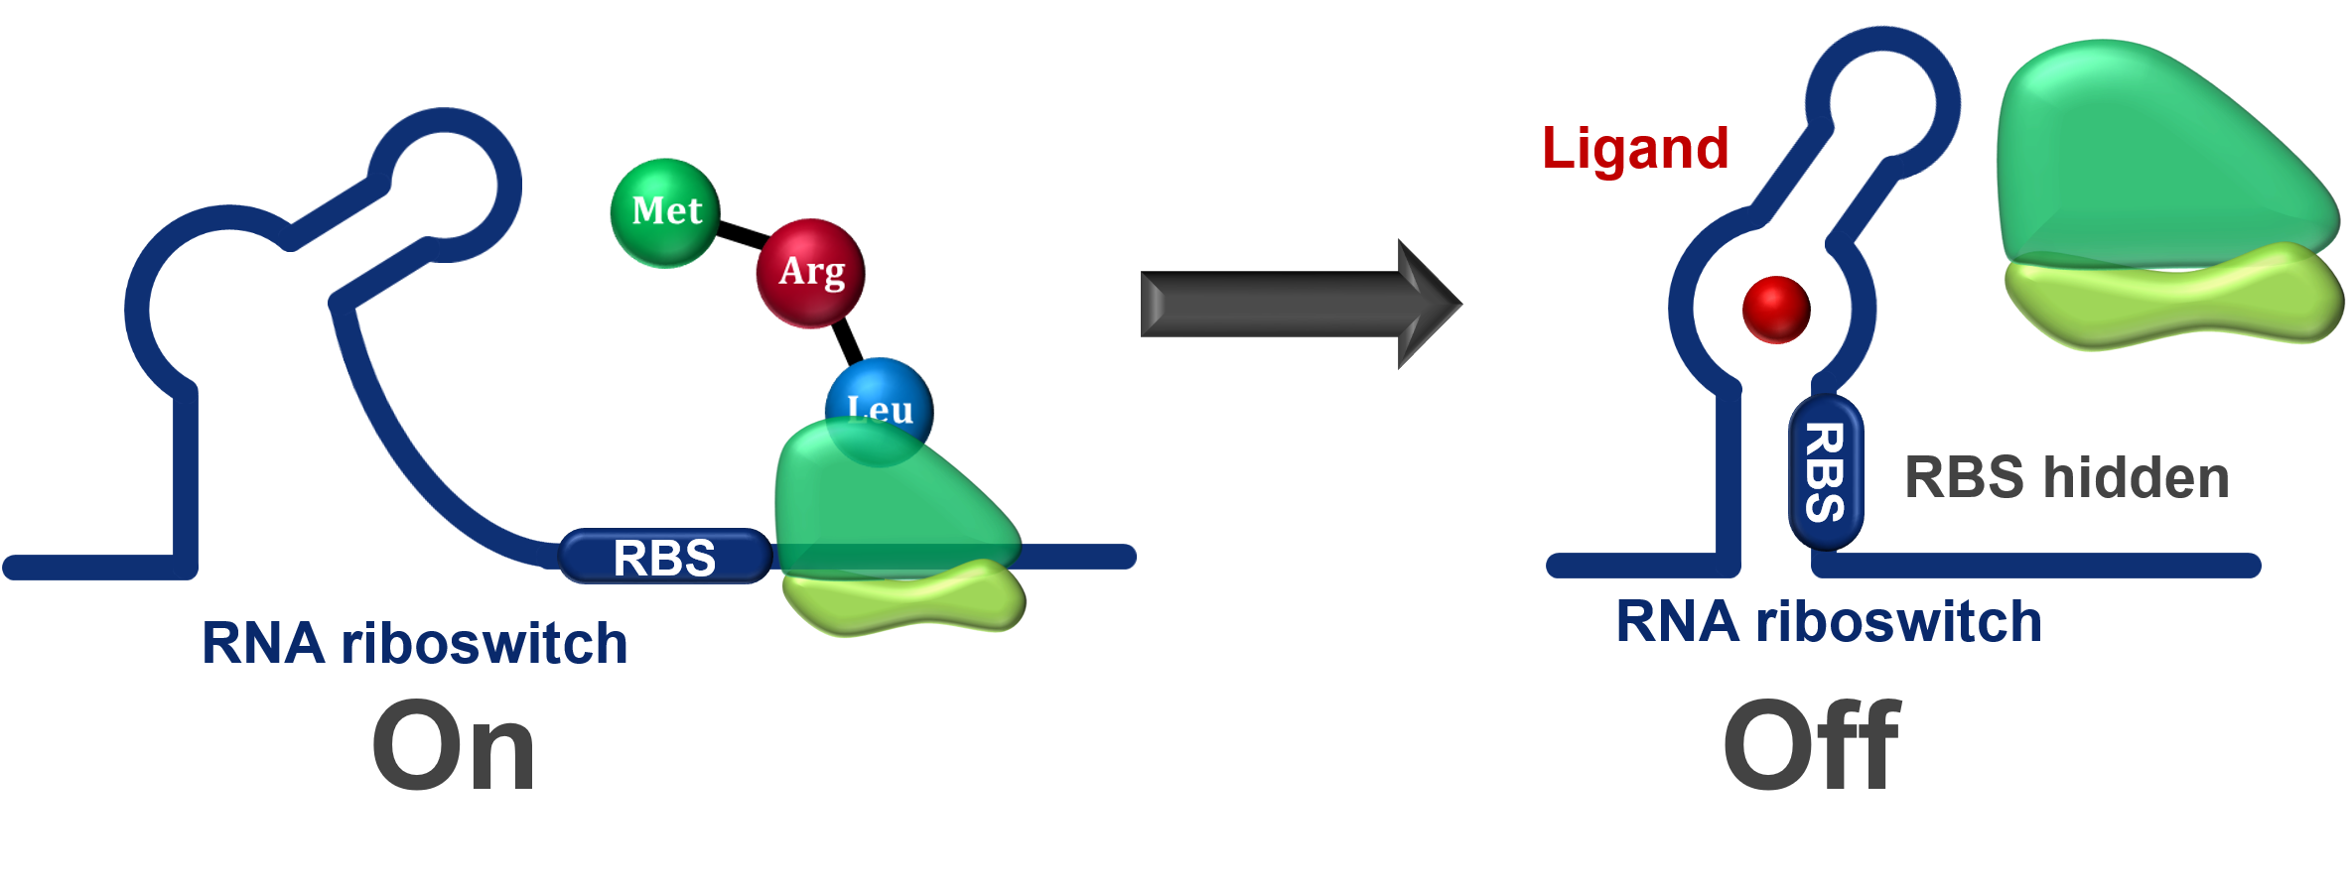
RIBOSWITCHES
Examples of RNA that regulate gene expression
Such regulation may occur at a variety of levels, including both transcription and translation.
Riboswitches are segments of RNA located on mRNA molecules close to the 5′ end. The riboswitch domain alternates between two different RNA secondary structures that determine whether or not the mRNA is expressed.
Unlike most regulatory RNA, riboswitches bind small effector molecules, such as amino acids or other nutrients. Binding of the effector molecule triggers a conformation change in the riboswitch. In most cases, effector binding terminates mRNA transcription prematurely or prevents mRNA translation.

Slide 27
Riboswitches Control mRNA Expression
Riboswitches alternate between two stem and loop structures depending on the presence or absence of the signal metabolite.
(A) In the attenuation mechanism, the presence of the signal metabolite results in formation of the terminator structure, and transcription is aborted.
(B) In the translational inhibition mechanism, the presence of the metabolite results in sequestration of the Shine–Dalgarno sequence, which prevents translation of the mRNA.
The only type of riboswitch found so far in eukaryotes is the thiamine riboswitch.

Slide 28
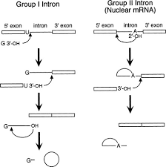
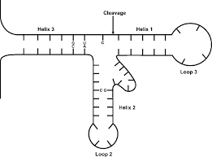
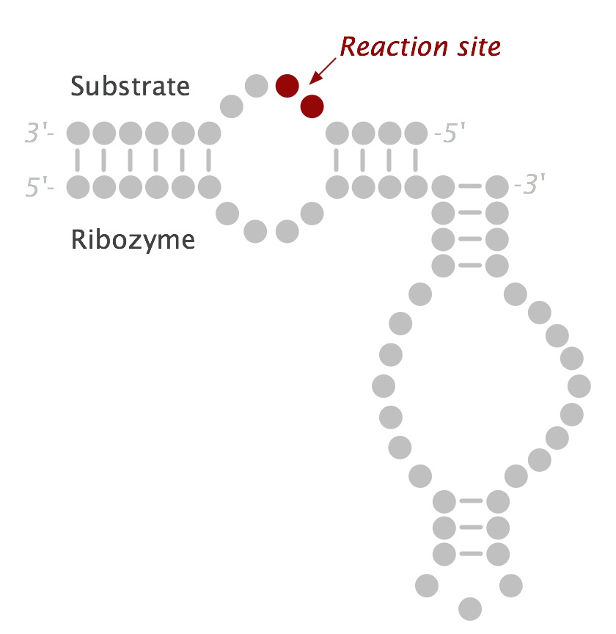
Ribozymes
Ribozymes are naturally occurring RNAs that can facilitate an enzymatic reaction.
Group I and group II introns are two types of ribozymes that can cleave the phosphate backbone release themselves from the mRNA molecule and rejoin the ends without using any protein enzymes.
The hammerhead ribozyme is a small catalytic RNA that can catalyze a self-cleavage reaction.
hairpin ribozymes cleave the linear concatemers of ssRNA genomes, much like hammerhead ribozymes, and then ligate the linear segments into circular genomes.

Slide 29
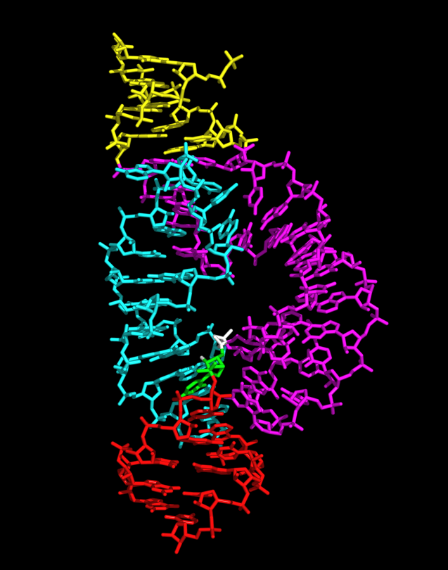
The engineered ribozyme can attack many target mRNA molecules because it is an enzyme, not merely an inhibitor. Using a ribozyme is much better than using antisense.
Adding a ribozyme motif such as the hammerhead or hairpin region from the small ribozymes can make antisense oligonucleotides more stable because they are not degraded. These constructs cut the target mRNA without the use of RNase H.

Slide 30
RNA SELEX IDENTIFIES NEW BINDING PARTNERS FOR RIBOZYMES
Natural ribozymes normally act on only one specific substrate.
One goal of biotechnology is to increase the number of substrates for the known ribozymes.
A procedure called RNA SELEX (Systematic Evolution of Ligands by EXponential enrichment) isolates new substrates for existing ribozymes from a large (1015) population of random-sequence RNA oligonucleotides

Slide 31
The key to RNA SELEX is using a very large pool of random RNA sequences.
First, DNA oligonucleotides are chemically synthesized to create a large pool of random sequences.
These are converted into dsDNA with a primer and Klenow polymerase. Primer consists of promoter for T7 RNA polymerase which creates ss RNA copies.
The primer adds an RNA polymerase binding site. The dsDNA oligonucleotides are transcribed into RNA with RNA polymerase.
This large pool of random RNA is then screened for binding to the ribozyme.
Any RNA molecules that bind are kept, and the rest are discarded.
Those that bind are converted to cDNA and amplified with PCR by 3 prim primer. The selection process is repeated numerous times to enrich for RNA sequences that bind more tightly to the ribozyme.

Slide 32
In Vitro Evolution of Ribozymes
In vitro evolution tries to find an RNA sequence that works as a ribozyme.
The pool of random RNA sequences is created and amplified with error Prone PCR to increase the odds of finding one or two sequences that catalyze the reaction. Each successive round of selection and mutation improves any ribozymes that are found.

Slide 33
Resource
Clark biotechnology – chapter 5

